Slide 1

DTAM: Dense Tracking and Mapping in Real-Time
Cognitive Robotics Seminar
Summer Semester 2012
Author: Aljoša Ošep
Mentor: Jörg Stückler

Slide 2
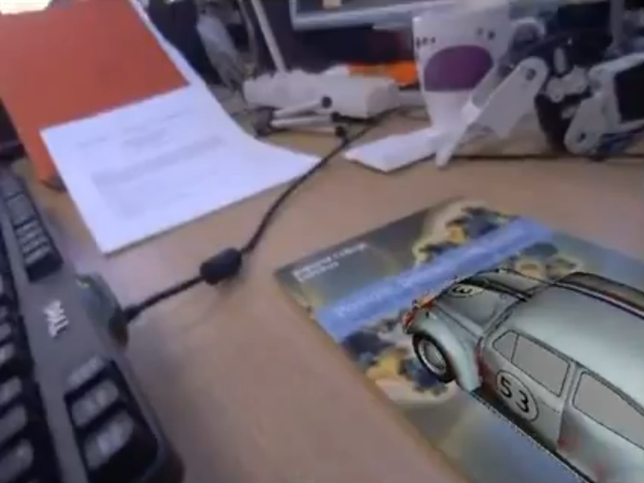
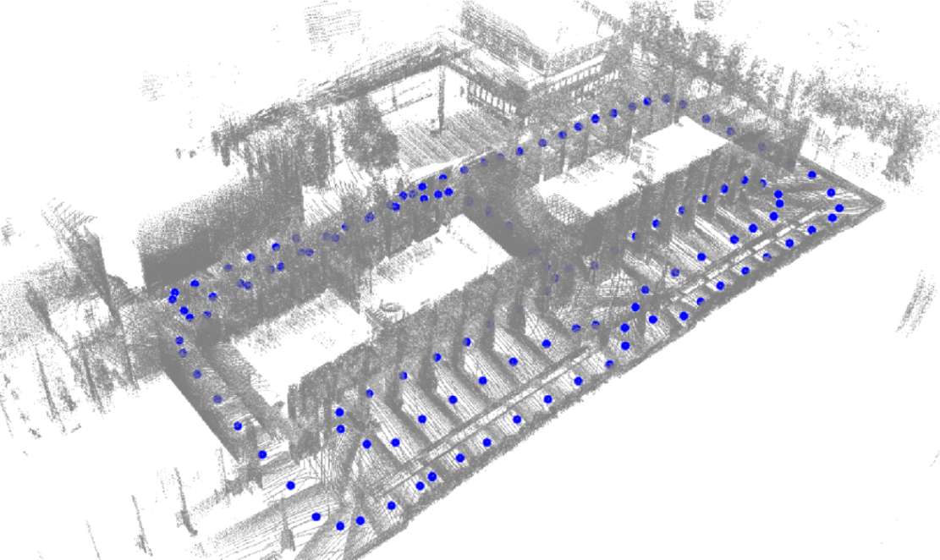
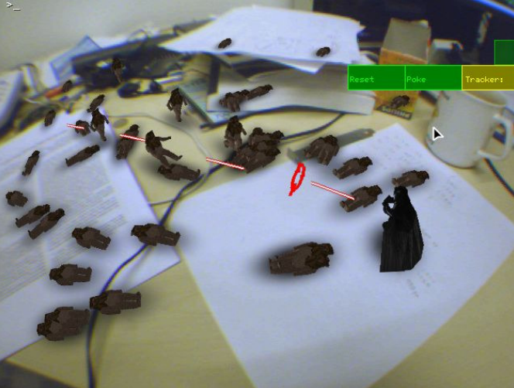
Motivation
Localization and Mapping in robotics
Augmented Reality
Image credits: Valencia et. al.,: 3D mapping for urban service robots , IROS'09 (left); Newcombe et. al.,: DTAM: Dense Tracking and Mapping in Real-Time, ICCV ’11 (right)

Slide 3
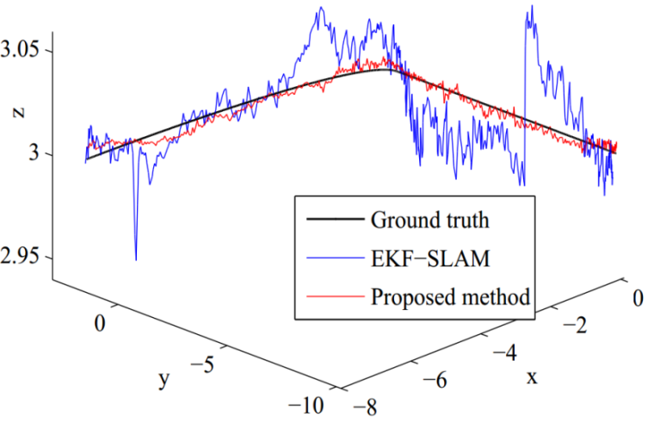
Previous and Related Work
Monocular SLAM
Structure-from-Motion
PTAM
Generation of map of 3D features
Tracking of handheld motion (no odometry info!)
Split tracking and mapping
Mapping: bundle adjustment
Tracking: back-projection of mapped features to camera image plane
Image credits: Klein et. al.,: Parallel Tracking and Mapping for Small AR Workspaces, ISMAR‘07

Slide 4
Overview
General Presentation of Method
Dense Scene Model Generation
Tracking
Variational Formulation
Energy Functional
Coupling of Terms
Primal-Dual Method

Slide 5
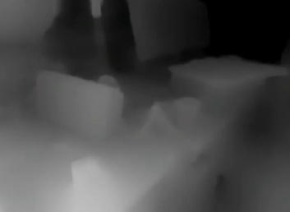
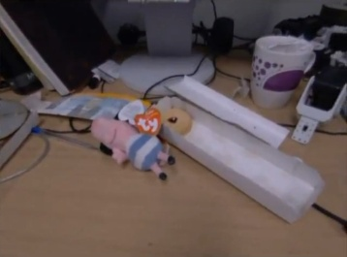

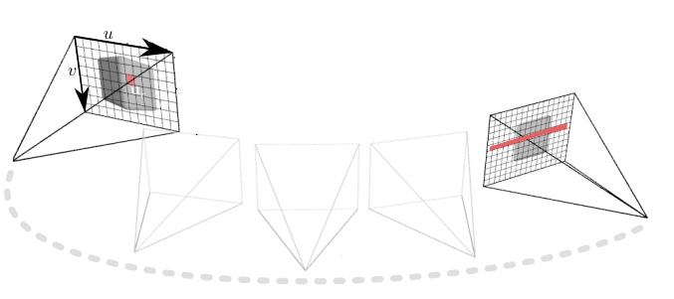
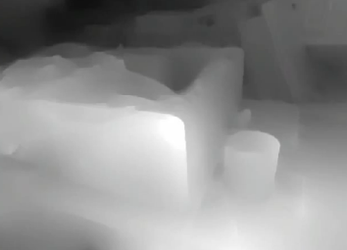
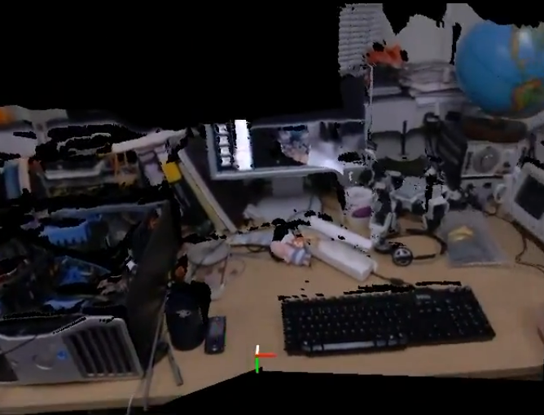
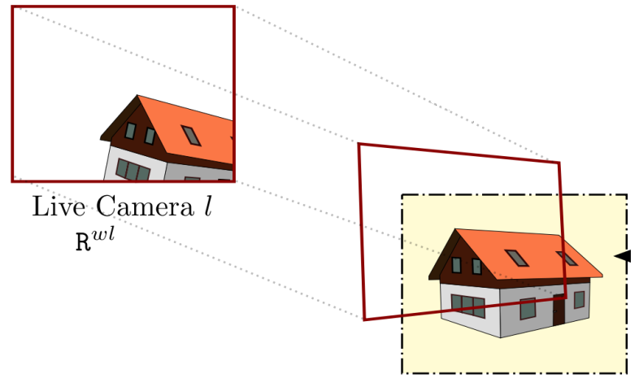
Approach
Image credits: Newcombe et. al.,: DTAM: Dense Tracking and Mapping in Real-Time, ICCV ’11; Lovegrove et. al.,: Real-Time Spherical Mosaicing using Whole Image Alignment, ECCV ‘10

Slide 6
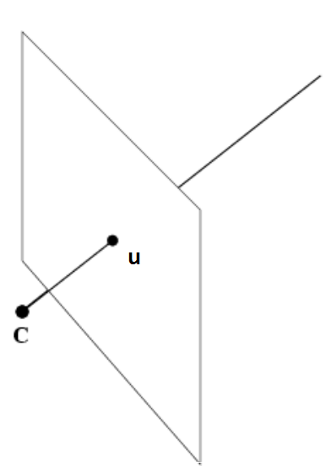
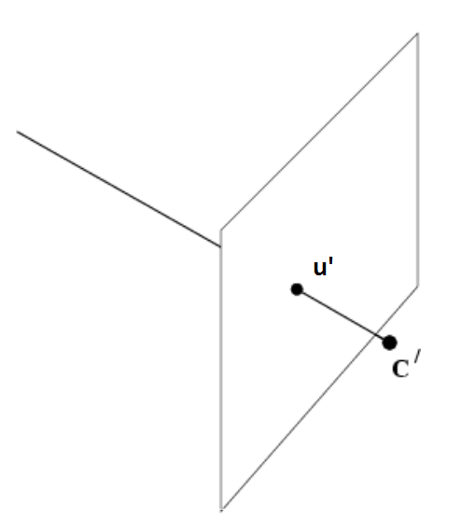

Dense Mapping: Preliminaries
Multi-view stereo reconstruction
Correspondence problem

Slide 7
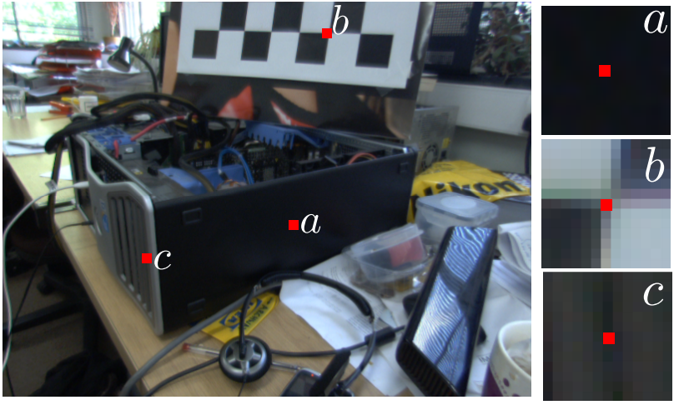
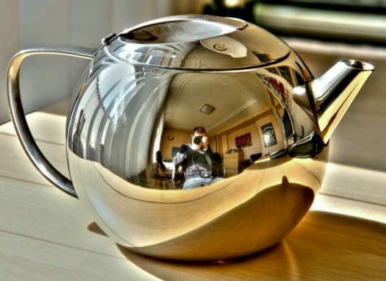
Dense Mapping: Challenges
Areas with similar appearance (e.g. flat areas)
Some materials exhibit complex reflectance behavior
Image credits: Newcombe et. al.,: DTAM: Dense Tracking and Mapping in Real-Time, ICCV ’11 (left); Canas et. al.,: A Liner Formulation of Shape from Specular Flow, ICCV’09 (right)

Slide 8
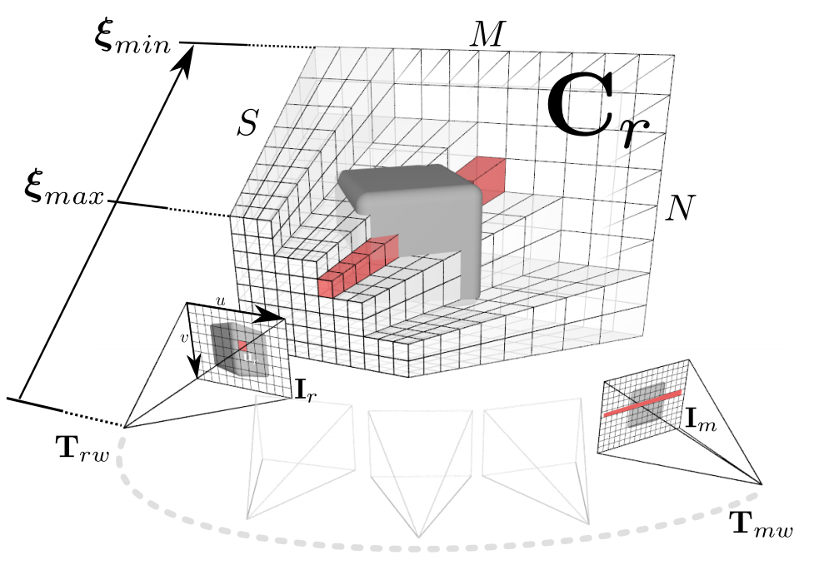
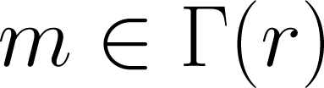
Dense Mapping
Estimate inverse depth map from bundles of frames
Image credits: R.A. Newcombe et. al.,: DTAM: Dense Tracking and Mapping in Real-Time, ICCV ’11

Slide 9
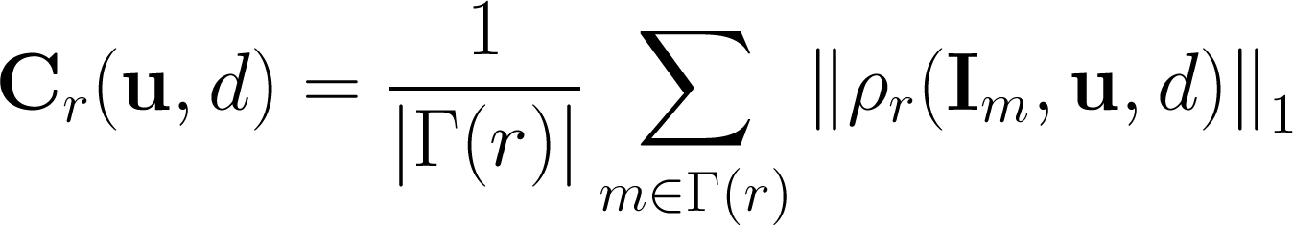

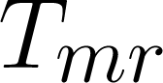
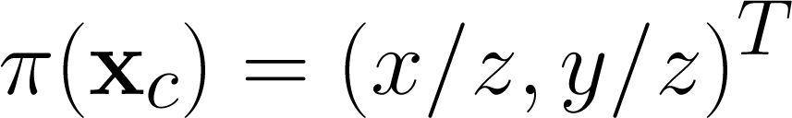
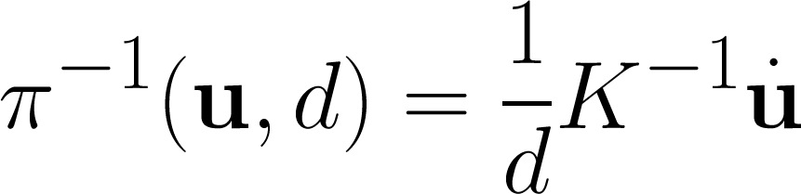
Photometric Error
Total cost
Photometric error
Where:
… intrinsic matrix
… transformation from frame r to m

Slide 10
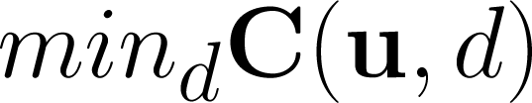
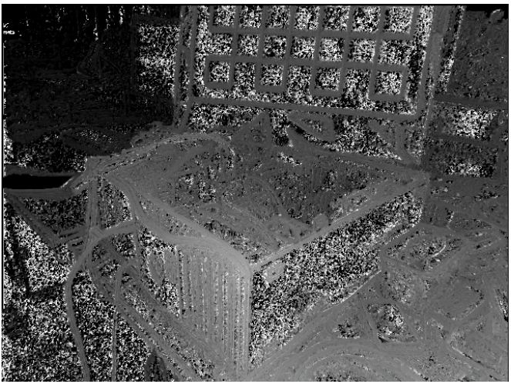
Inverse Depth Map Computation
Inverse depth map can be computed by minimizing the photometric error (exhaustive search over the volume):
But …
Image credits: R.A. Newcombe et. al.,: DTAM: Dense Tracking and Mapping in Real-Time, ICCV ’11

Slide 11
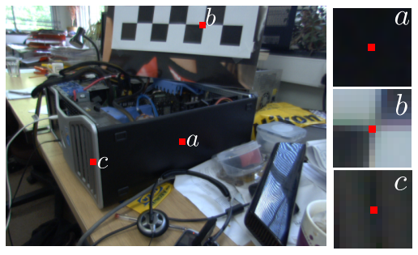
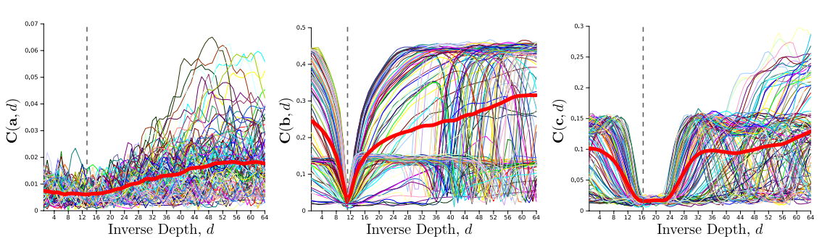
Inverse Depth Map Computation
Image credits: R.A. Newcombe et. al.,: DTAM: Dense Tracking and Mapping in Real-Time, ICCV ’11

Slide 12

Tracking
Based on image alignment against dense model
Coarse-to-fine strategy
Pyramid hierarchy of images
Lucas-Kanade algorithm
Estimate “warp” between images
Iterative minimization of a cost function
Parameters of warp correspond to dimensionality of search space
Image credits: Lovegrove et. al.,: Real-Time Spherical Mosaicing using Whole Image Alignment, ECCV‘10

Slide 13
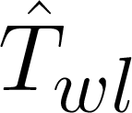

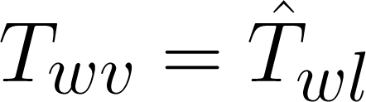
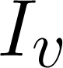
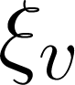
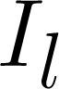
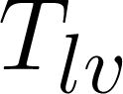
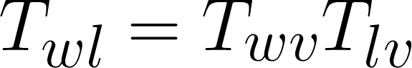
Tracking
Two stages
Constrained rotation estimation
Use coarser scales
Rough estimate of pose
Accurate 6-DOF pose refinement
Set virtual camera at location
Project dense model to the virtual camera
Image , inverse depth image
Align live image and to estimate
Final pose estimate

Slide 14
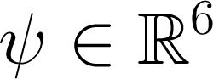
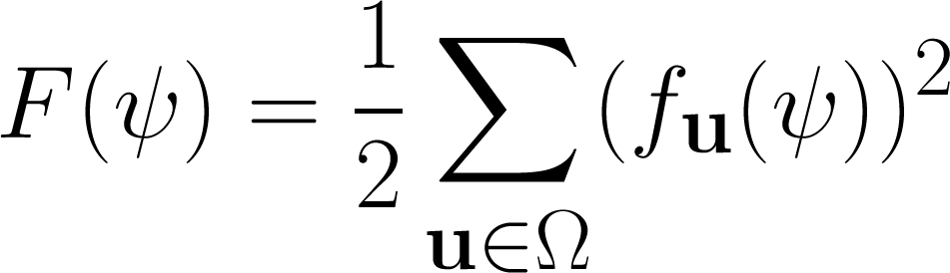
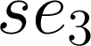
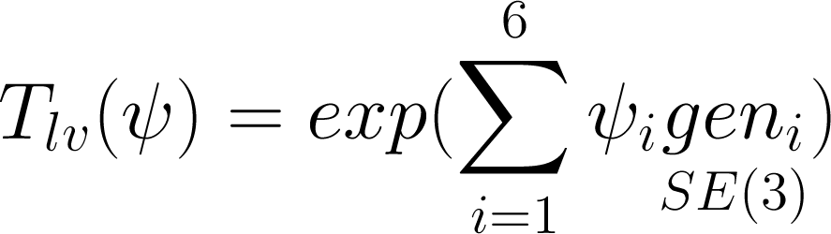
6-DOF Image Alignment
Gauss-Newton gradient descent non-linear optimization
Non-linear expression linearized by first-order Taylor expansion
Belongs to Lie Algebra

Slide 15

Back to Inverse Depth Map Computation
Featureless regions are prone to false minima
Solution: Regularization term
We want to penalize deviation from spatially smooth solution
But preserve edges and discontinuities

Slide 16
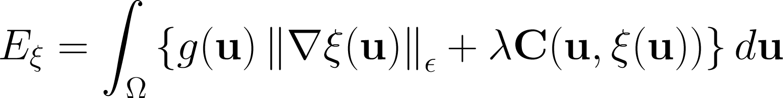
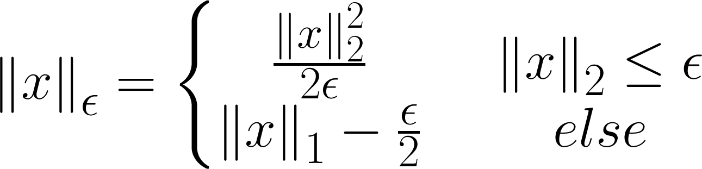
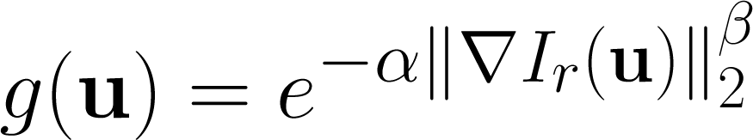
Energy Functional
Regularized cost
Regularization term
Photometric cost term
Huber norm
Weight

Slide 17
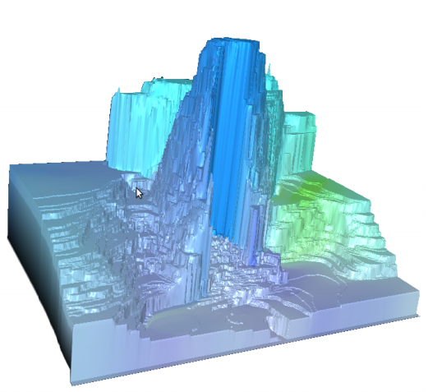
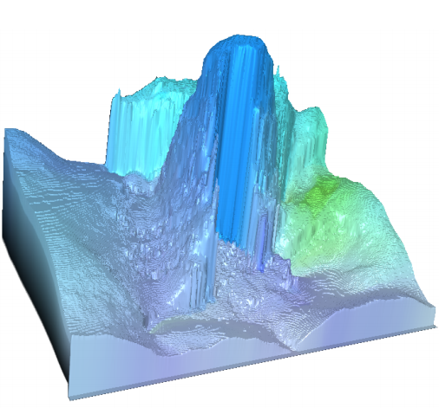
Total Variation (TV) Regularization
L₁ penalization of gradient magnitudes
Favors sparse, piecewise-constant solutions
Allows sharp discontinuities in the solution
Problem
Staircasing
Can be reduced by using quadratic penalization for small gradient magnitudes
Image credits: Werlberger et. Al.: Anisotropic Huber-L1 Optical Flow, BMVC‘09

Slide 18
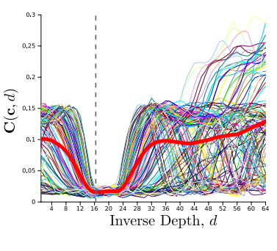
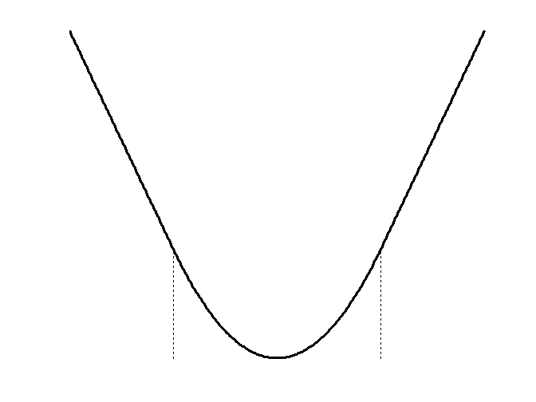
Energy Functional Analysis
Composition of L₁ and L₂ norm
Obviously convex ☺
Obviously not convex ☹

Slide 19
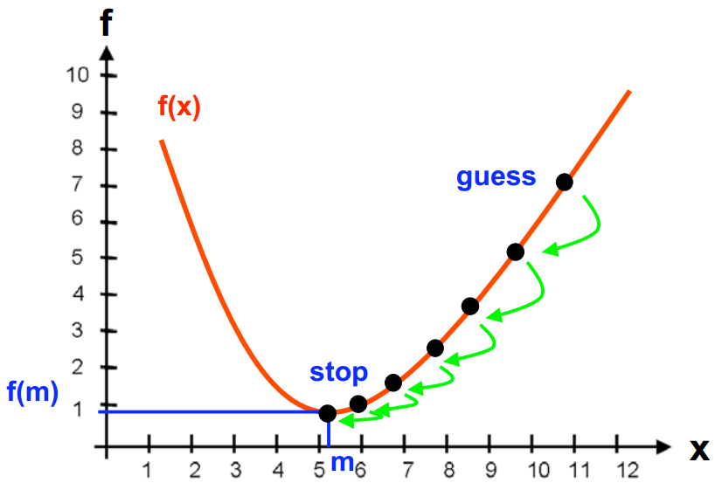

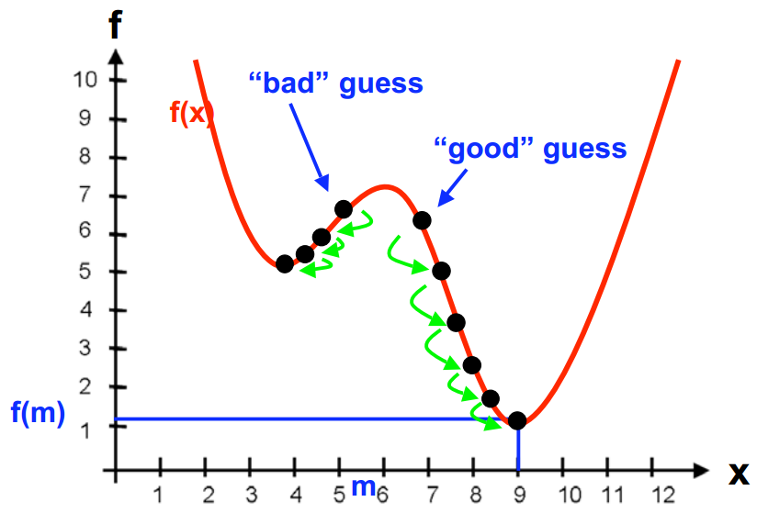
Why do Computer Scientists Like Convex Functions?
Problem,
optimization algorithm?
Convex function
Non-Convex function

Slide 20

Energy Minimization
Composition of both terms is non-convex function
Possible solution
Linearize the cost volume to get a convex approximation of the data term
Solve approximation iteratively within coarse-to-fine warping scheme
Can lead in loss of the reconstruction details
Can we do better?

Slide 21
Alternating two Global Optimizations
Key observation:
Data term can be globally optimized by exhaustive search
Convex regularization term can be solved efficiently by convex optimization algorithms
Decoupling scheme
Steinbrücker et. al.
Decouple data and regularity term

Slide 22

Alternating two Global Optimizations
Approx. energy functional
Decouple data and regularity term
Optimization process is split into two sub-problems
Terms are decoupled via aux. variable
Drives original and aux. variables together
Minimizing functional above equivalent to minimizing original formulation as
[A. Chambolle: An Algorithm for Total Variation Minimization and Applications]

Slide 23
Alternating two Global Optimizations
Seems we are just making things more complicated, but:
Energy functional can be globally minimized w.r.t
Since it is convex in
E.g. gradient descent
Energy functional can be globally minimized w.r.t
Not convex w.r.t , but trivially point-wise optimizable
Exhaustive search

Slide 24
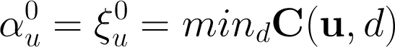
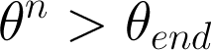
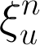
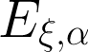
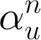
Algorithm
Initialization
Compute
= large_value
Iterate until
Compute
Minimize with fixed
Use convex optimization tools, e.g. gradient descent
Compute
Minimize with fixed
Exhaustive search
Decrement

Slide 25
Can we do Even Better?
Yes!
Primal-Dual approach for convex optimization step
Acceleration of non-convex search
Sub-pixel accuracy

Slide 26
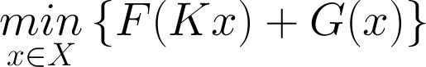



Preliminaries: Primal-Dual Approach
General class of energy minimization problems:
Can obtain dual form by replacing by its convex conjugate
Usually regularization term
Often a norm:
Data term

Slide 27



Preliminaries: Primal-Dual Approach
General problem formulation:
By definition (Legendre-Fenchel transform):
Dual Form (Saddle-point problem):

Slide 28



Preliminaries: Primal-Dual Approach
Conjugate of Huber norm (obtained via Legendre-Fenchel transform)

Slide 29



Minimization
We are solving saddle point problem now!
Condition of optimality met when
Compute partial derivatives
Perform gradient descent
Ascent on (maximization)
Descent on (minimization)

Slide 30




Putting Everything Together
First some notation:
Cost volume is discretized in array
We consider stacked column vectors of and
d … vector version of
a … vector version of
q … vector with weights
… weighting matrix
Ad computes gradient vector

Slide 31


Implementation
Replace Huber regularizer by its conjugate
Saddle-point problem
Primal variable d and dual variable q
Coupled with data term
Sum of convex and non-convex functions
F(AGd)
F*(q)
F*(q)
G(u)

Slide 32


Implementation
We also need partial derivatives
For fixed a, gradient ascent w.r.t q and gradient descent w.r.t d is performed
For fixed d, exhaustive search w.r.t a is performed
is decremented
Iterated until

Slide 33





Optimizations
Accelerating non-convex solution
Increasing solution accuracy
Image credits: Newcombe et. al.,: DTAM: Dense Tracking and Mapping in Real-Time, ICCV ’11

Slide 34


Evaluation and Results
Runs in real-time
NVIDIA GTX 480 GPU
i7 quad-core CPU
Grey Flea2 camera
Resolution 640x480
30 Hz
Comparison with PTAM
Image credits: Newcombe et. al.,: DTAM: Dense Tracking and Mapping in Real-Time, ICCV ’11

Slide 35




Evaluation and Results
Unmodelled objects
Camera defocus
Image credits: Newcombe et. al.,: DTAM: Dense Tracking and Mapping in Real-Time, ICCV ’11

Slide 36
Conclusions and Future Work
Significant advance in real-time geometrical vision
Very robust
Rapid motion
Camera defocus
Brightness constancy assumption
Often violated in real-world
Not robust to global illumination changes
Challenge for future work
In context of robotics, more efficient model presentation would be interesting
E.g. Octree

Slide 37
Thank you for your attention.

